Slide 1

Food Producers Sanitation
Moore Purity, Inc.
42+ year Experience
Creating Patented technologies
July 31,2025

Slide 2

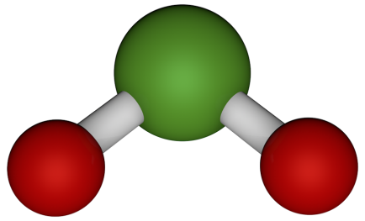
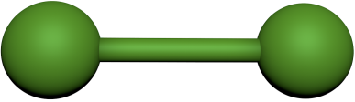
ClO2 – Chlorine Dioxide Very different from Chlorine
Chlorine Dioxide has chlorine in its name, its chemistry is dramatically different from that of chlorine.
Due to their fundamental differences, they react differently with organics.
Chlorine reacts and creates dangerous byproducts
Chlorine dioxide does not react, it oxidizes / redox process.
ClO₂
Cl₂

Slide 3
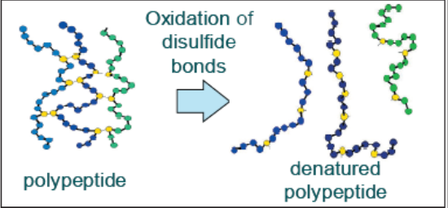
Moore Purity ClO2 Always Ready To Work
ClO₂ is a powerful disinfectant that works rapidly via oxidation to provide broad spectrum performance against:
Bacteria and bacterial spores,
Fungi and their spores,
Algae, and viruses.
ClO₂ disinfects via two separate mechanisms:
As a permeable gas, ClO₂
Diffuses through the protective layer of the cell
Breaks up the biofilm and
Alters the permeability of the outer cell membrane.
Inside the cell ClO₂
Inactivates the cell from the inside out
Inhibiting critical cell functions, including the disruption of protein synthesis.
ClO2’s collective cellular damage at the molecular level makes ClO₂ both broad spectrum and effective at very low dose rates never a concern regarding built-up resistance.

Slide 4
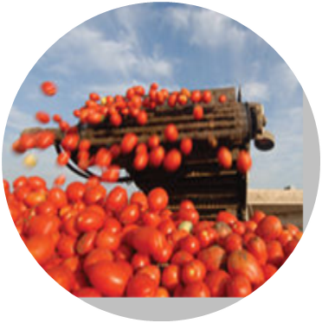
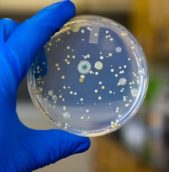
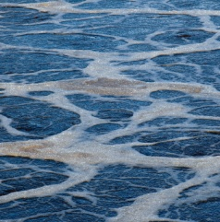
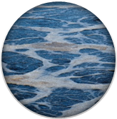
ClO2 Chemistry
Chemistry is well understood no surprises.
Applications are absolutely unique to each facility and requires superior experience to execute properly.
Microbial Control
Process water microbial control
Legionella control, hepatitis, listeria
E.coli bacteria, salmonella
Yeast, mold, spores
Biofilm elimination
Food
Hard surface sanitizer
Fruit & vegetable processing
CIP
Belt Spray
Entryway Foamer
Process Water
Potable water disinfection
Food rinse
Flume water
Bottle wash
Odor Abatement / Control
Rendering odor control
Hydrogen sulfide
NOx oxidation

Slide 5
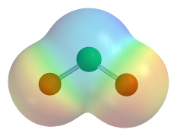



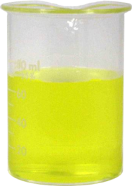
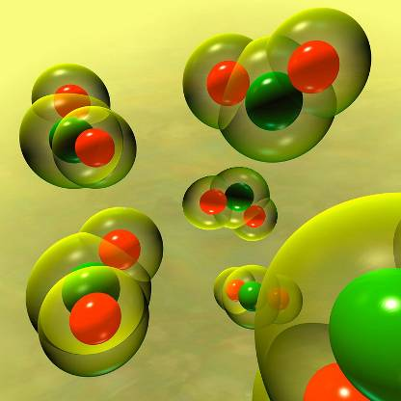
Properties
Highly soluble in water and exists as a gas in water
Reacts by Oxidation / Redox
Has an odor similar to chlorine
Effective over wide pH range (2-10)
Exhibits a yellow-green color, becoming more red as concentration increases
“Recyclable”
Selective Oxidation / Rapid Reaction
Density: 2.4 times heavier than air
Chemical Formula: ClO₂
Molar mass: 67.453g/mol
Molar absorptivity (360nm): 1250(M-cm)⁻¹
Specific Gravity of liquid at 0℃: 1.64
-59℃ (-74℉)
11℃ (52℉)
Solid
Liquid
Gaseous
Gaseous
Solution

Slide 6



ClO2 Oxidizes Not React
ClO₂ does not Chlorinate Organics or form THM’s or HAA’s:
Chlorination reaction with Cl₂:
R⁻H + Cl₂
R⁻Cl + HCl
Organic
Chlorinated Organic
Acid
Oxidation reaction with ClO₂:
R⁻H + ClO₂
ClO₂⁻
Organic
Chlorite

Slide 7
ClO2 vs. Cl2
One of the most important properties of chlorine dioxide that sets it apart from chlorine is its behavior when placed in water
ClO₂:
Chlorine dioxide is 10 times more soluble in water than chlorine (3.01 grams/liter at 25 degrees C)
ClO₂ doesn't hydrolyze when placed in solution. It remains as a "true" dissolved gas
Retains its useful oxidative and biocidal properties throughout broad pH range (2 to 10 pH)
Cl₂:
Chlorine disassociates when placed in water to form hypochlorous acid chlorine gas
Hypochlorous acid is the primary biocide in solution, which disassociates to form hypochlorite ion with increasing pH
Hypochlorite ion is far less effective in controlling microbes as hypochlorous acid
Chlorine is an effective biocide only in systems where pH is < 8.0 however highly corrosive and full of dangerous byproducts

Slide 8

ClO2 “Selective” Economics
RELATIVE ECONOMICS
CHLORINE
HOCl + NaBr
CHLORINE DIOXIDE
BCDMH
OZONE
INCREASING SYSTEM CONTAMINATION

Slide 9
Chlorine Dioxide is a “Mild” Oxidizer but with 5 Electrons has a lot of Capacity to Oxidize
Oxidant Species Formula Oxidation Potential Eo(Volts) Oxidation Capacity
Hydroxyl free radical OH⁻ 2.80 2e⁻
Ozone O₃ 2.07 2e⁻
Hydrogen peroxide H₂O₂ 1.76 2e⁻
Permanganate ion MnO₄⁻ 1.68 3e⁻
Chlorous acid HClO₂ ~1.6 4e⁻
Hypochlorous acid HOCl 1.49 2e⁻
Molecular Chlorine Cl₂ 1.36 2e⁻
Hypobromous acid HOBr 1.33 2e⁻
Molecular Bromine Br₂ 1.07 2e⁻
Hypoiodous acid HOI 0.99 2e⁻
Chlorine dioxide ClO₂ 0.95 5e⁻
Molecular Iodine I₂ 0.54 2e⁻
Oxygen O₂ 0.40 2e⁻
Hypochlorite Ion ClO⁻ <0.50 2e⁻
This selectivity of ClO2 versus other oxidative micro biocides results in a lower dosage requirement and minimizes the potential of disinfection by products.
The more contaminated the system, the more economically attractive CLO2 becomes.

Slide 10
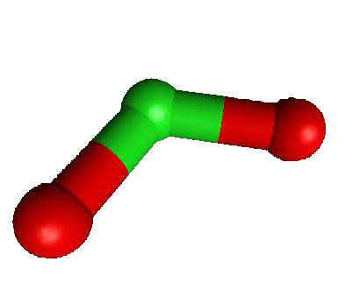
Chlorine Dioxide Offers the Food Industry a Unique Combination of Advantages
Highly Efficacious Against Food Borne Pathogens and Spoilage Organisms Improves Food Safety and Extends Shelf Life
Relatively Low Applications Levels Result in Favorable Costs
Safe to Use: Non-toxic Degradation By-products (NaCl)
Non-chlorinating: Does Not Form Carcinogenic and Mutagenic THM’s
Relatively Low Interaction With High Organic Loads Increases Its Effectiveness in Process Water
Broad Spectrum Biocide That Is Effective Against Most Bacteria, Viruses, Fungi and Algae Including Listeria and E.Coli in Wide pH and Temperature Ranges
4 – 6 Log Kill Against E.Coli Vs 1- 2 Log Kill With Cl₂
Maintains Sanitary Condition of Process Water - Does Not Treat Food, does not impart taste
Organisms Cannot Develop Immunity or resistance

Slide 11
Cooling Tower & Flumes
Major Advantages in the use of ClO₂:
Chlorine dioxide demand is not affected by hydrocarbon leaks or ammonia.
It improves heat transfer resulting in energy savings.
It is more effective at killing biofilm for cleaner heat transfer surfaces.
It decreases under-deposit corrosion
It allows corrosion inhibitors to more effectively contact and passivate metal surfaces.
Intermittent feed performs better than chlorine or bromine fed continuously.

Slide 12


ClO2 Effectively Reduces Biofilm Formation
ClO₂ and Biofilm:
ClO₂ effectively reduces biofilm formation and provides control of biofilm growth
Biofilms are known to reduce flow and harbor SRB’s
As a true dissolved gas, ClO₂ effectively penetrates the polysaccharide-based biofilm substrate
Effective microbe kill throughout and beneath the biofilm includes SRB’s and APB’s that can cause MIC
Recycle of ClO₂: ClO₂ → ClO₂⁻ + H⁺ → ClO₂ → ClO₂⁻ + H⁺→ ClO₂ → ClO₂⁻ + H⁺→
ClO₂ can be “reduced” in the presence of other ions to Cl⁻
ClO₂ Penetrates
HOCl Repelled
HOBr Repelled
Negative Surface Charge
BIOFILM
Corrosion
Corrosion
SUBSTRATE

Slide 13
ClO2 Biofilm Kill Mechanism
ClO₂ Penetrates
HOCl⁻ Repelled
HOBr⁻ Repelled
Negative Surface
Charge
_
_
_
_
_
_
_
_
_
_
_
_
_
_
_
_
_
_
_
_
_
_
_
_
Biofilm
Substrate

Slide 14
Moore Purity ClO2 Generator Systems
Key Drivers
Safety – Efficiency – Low Operating Costs
Innovative Mechanical Designs
Innovative Electronics
Cloud monitoring systems
Designed to function precisely together

Slide 15
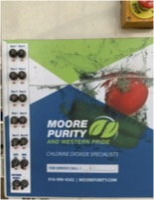
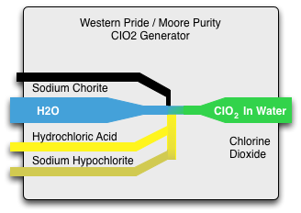
Moore Purity ClO2 Generator Systems
Each system supports multiple generation methods.
Large systems are vacuum draw of all chemicals.
No water flow = no production, Safety.
High efficiency ClO2 generator for food processing applications.
Immediate dilution of reacted chemicals = Safety.
Check valves, affirmative solenoid interlocks.
Electronic data monitoring and reporting.

Slide 16
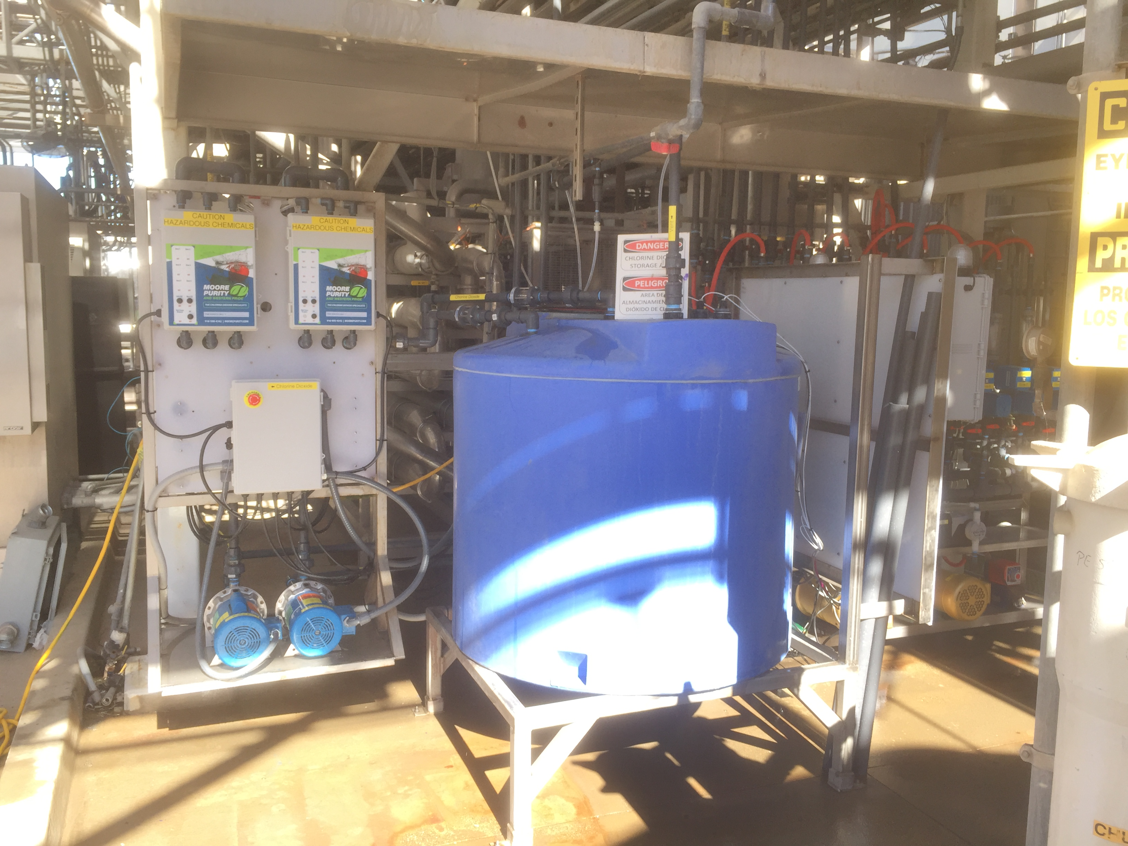
Scale ClO2 Generation 250 GPM System

Slide 17
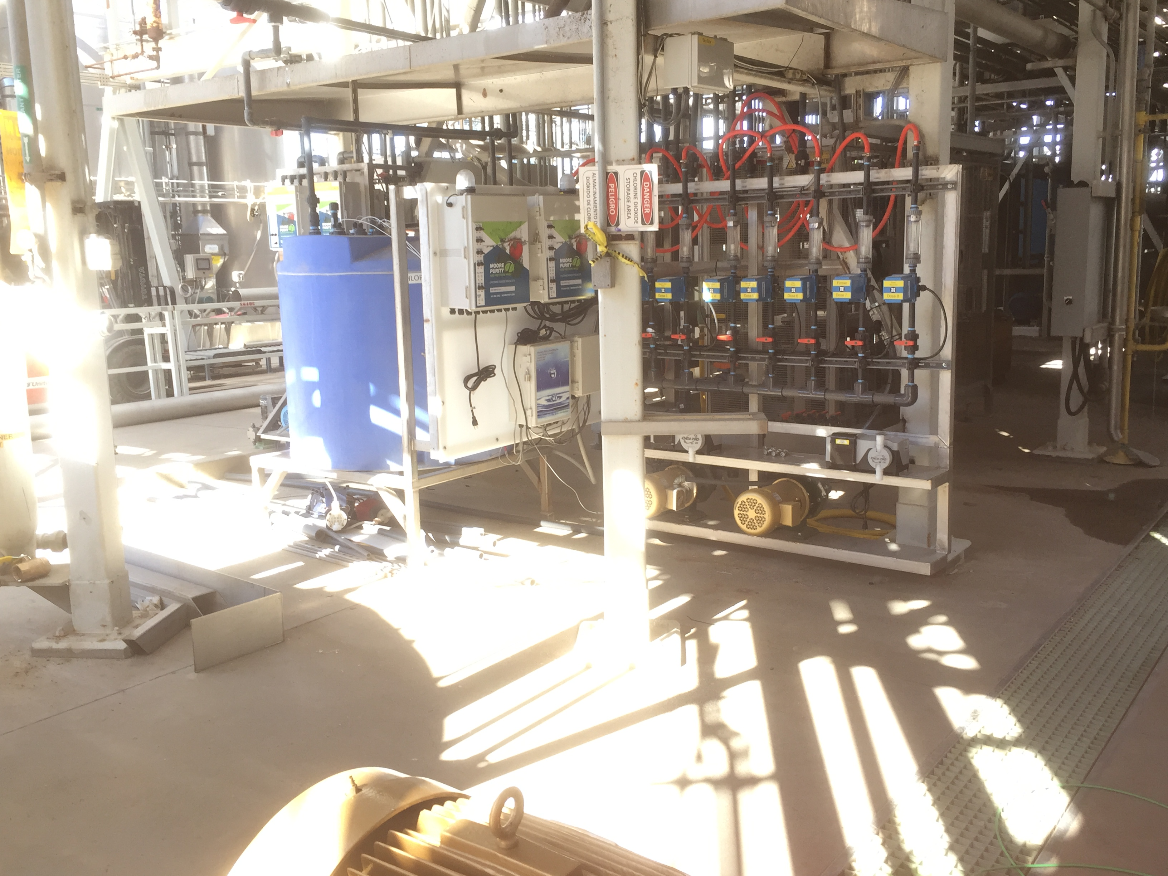
Scale ClO2 Dosing 250 GPM System

Slide 18
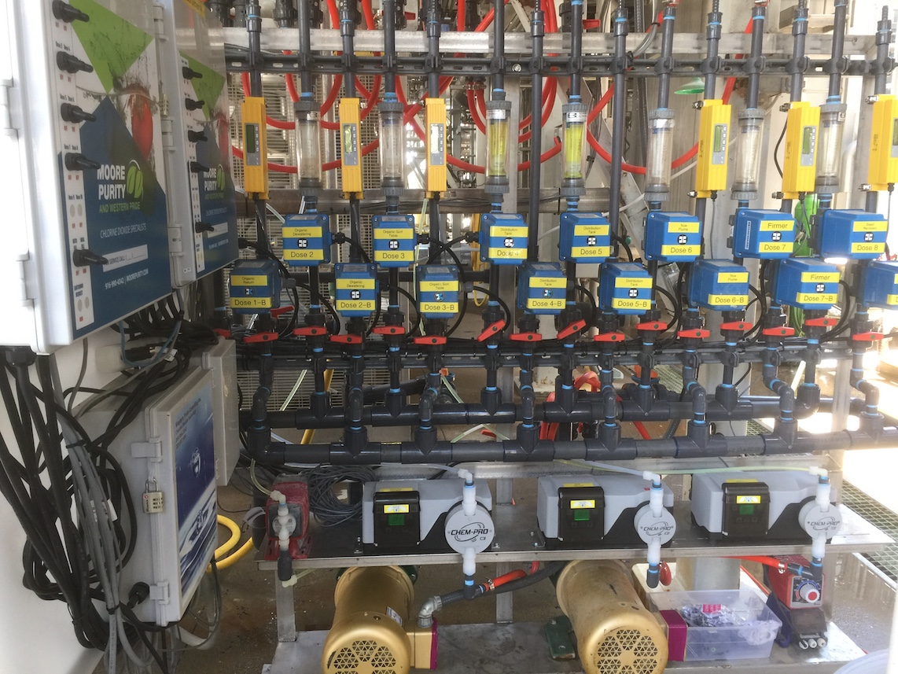
Scale ClO2 Dosing 250 GPM System

Slide 19
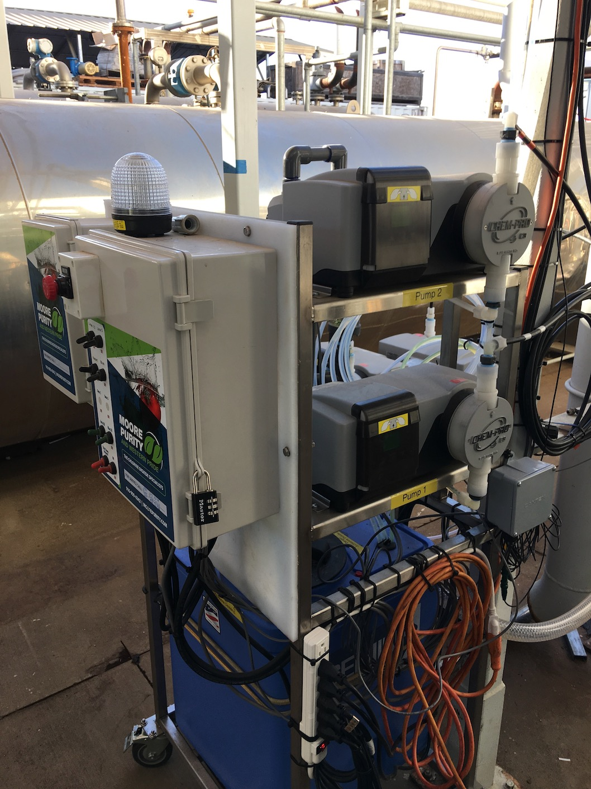
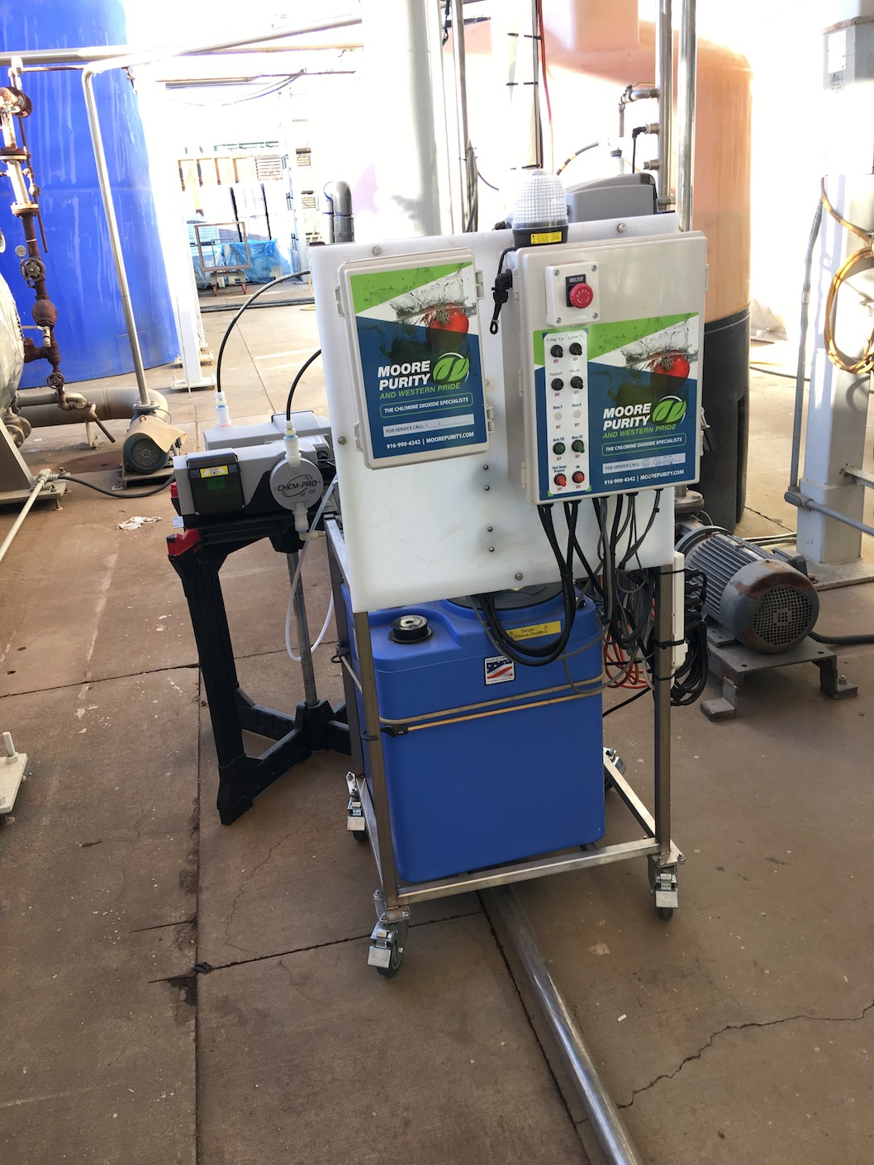
Scale ClO2 Dosing Cart System

Slide 20
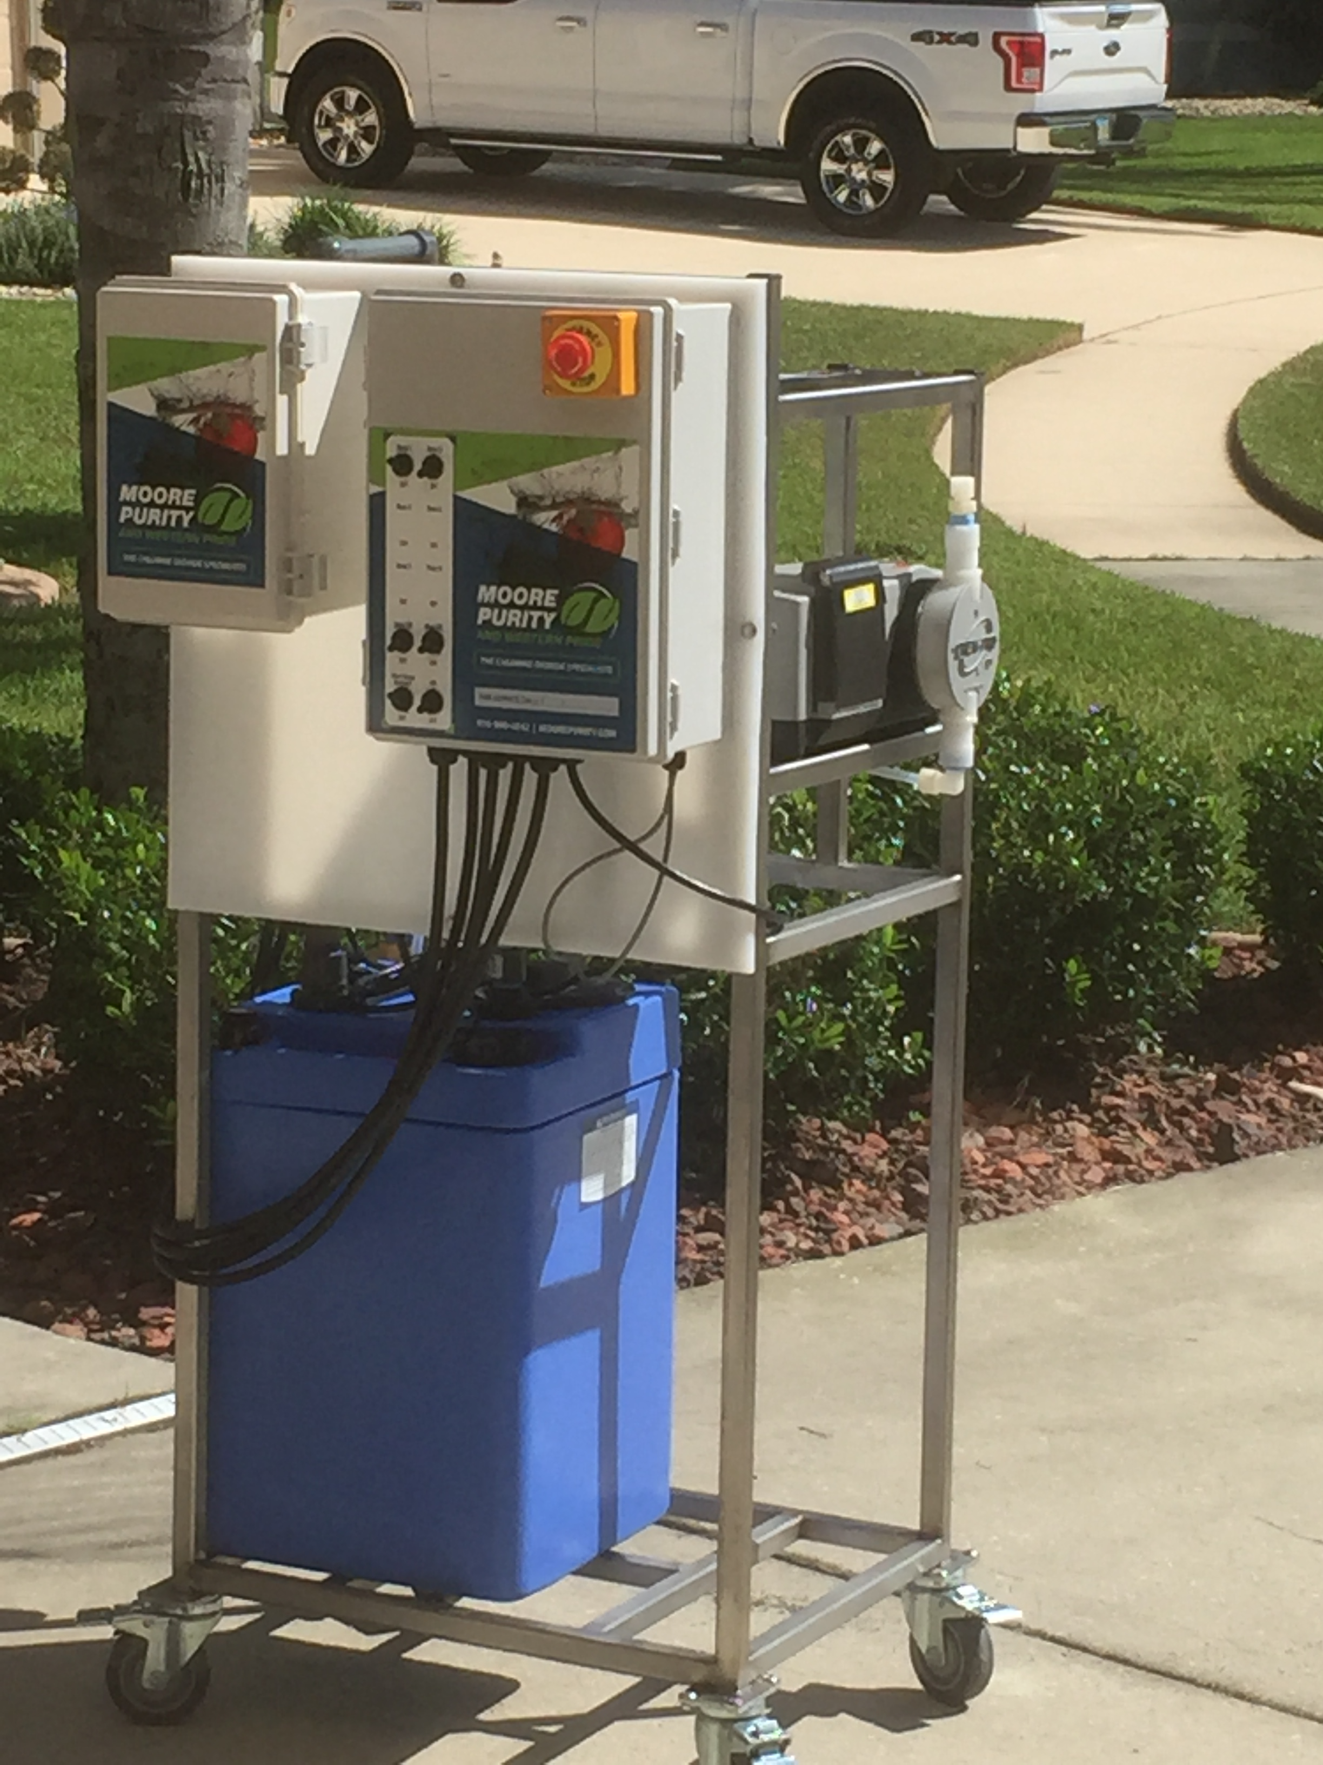
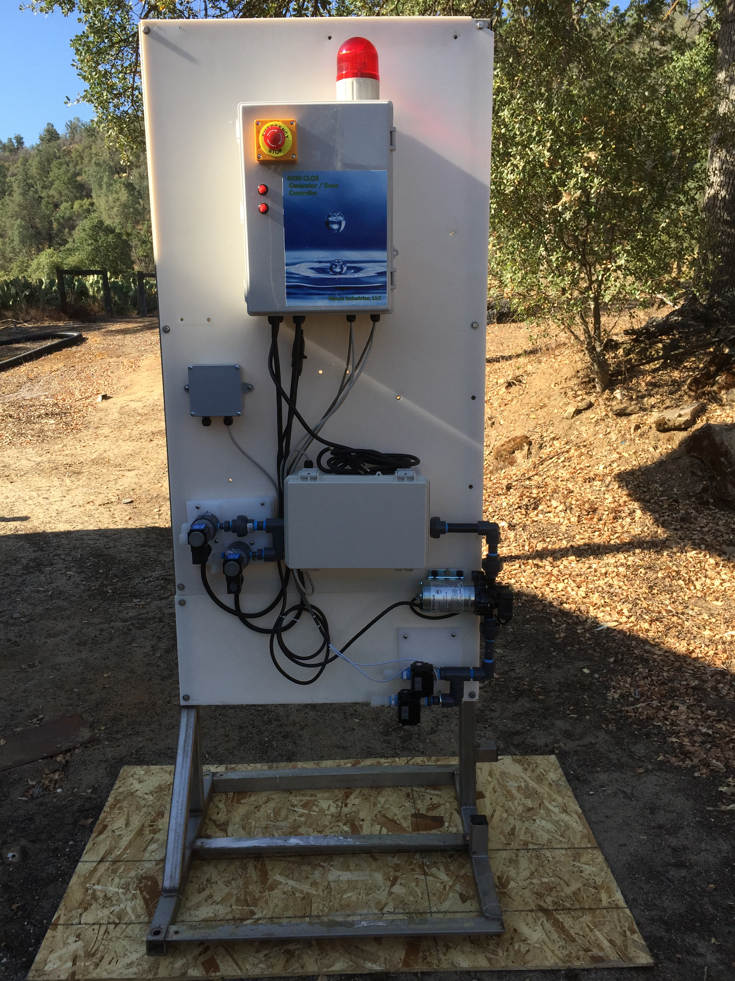
Reacting ClO2 and Return to Source Draw, React, Return
Portable systems

Slide 21
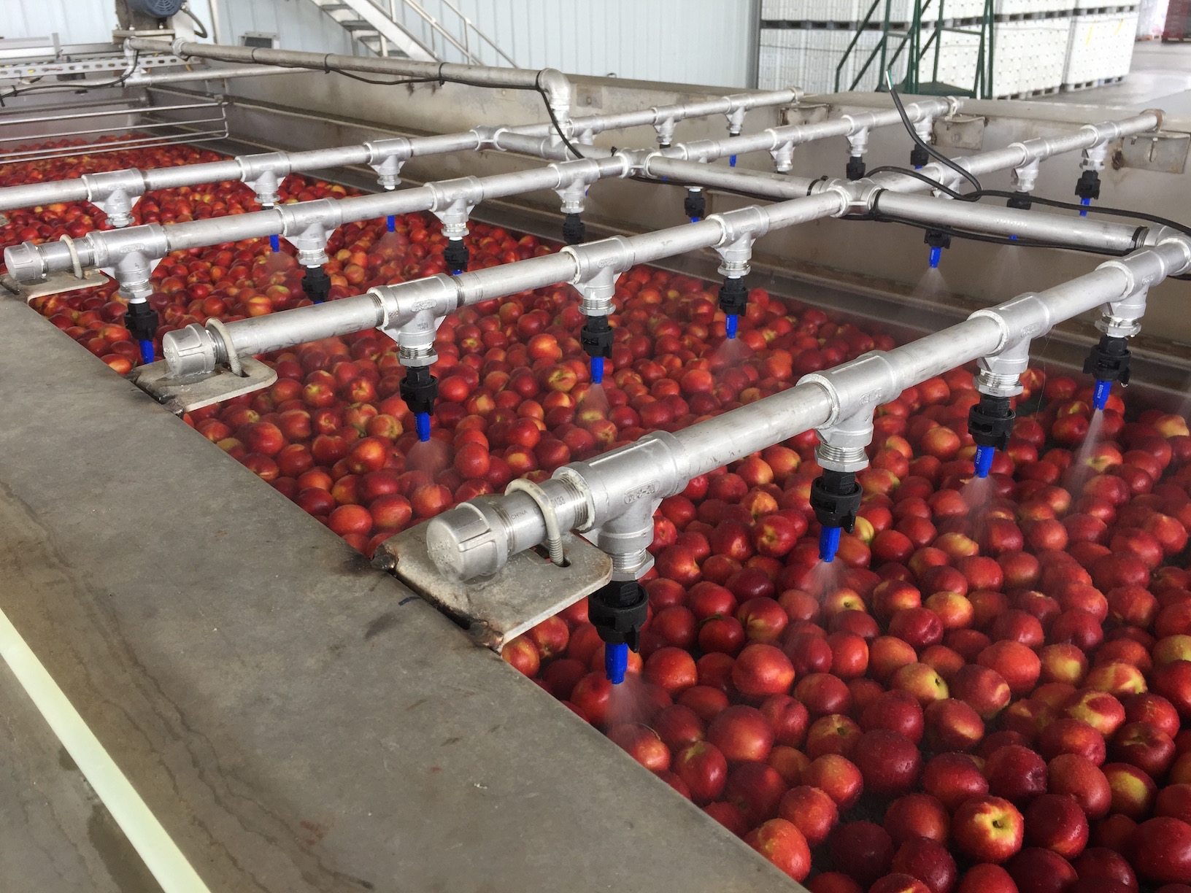
Peaches & Nectarine's

Slide 22
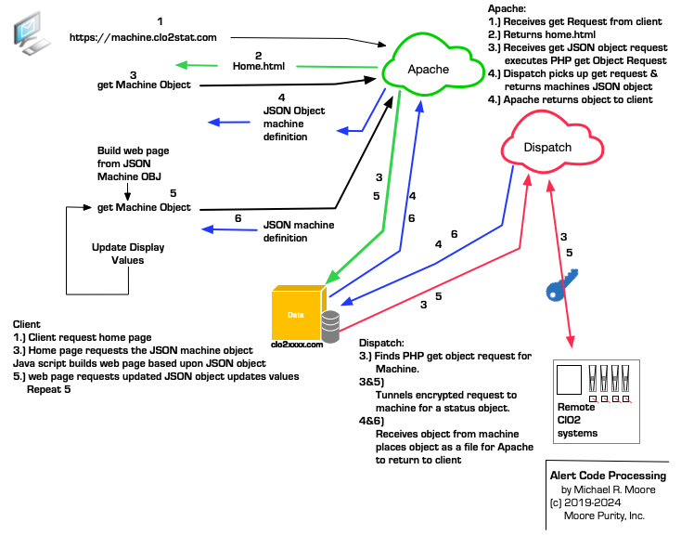
Machine Status Moore Purity Cloud Services

Slide 23
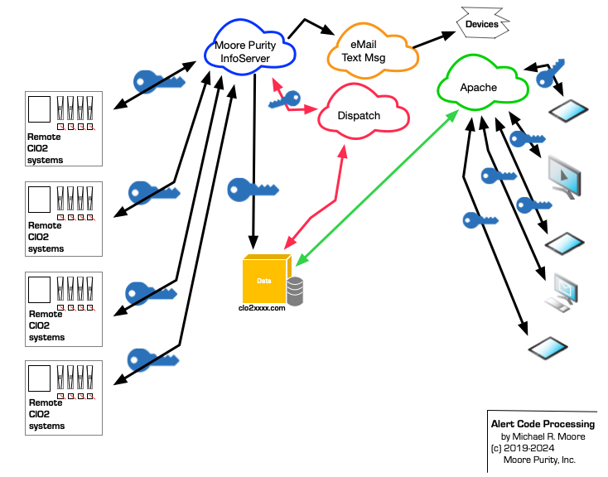
Machine Dispatch Services Moore Purity Cloud Services

Slide 24
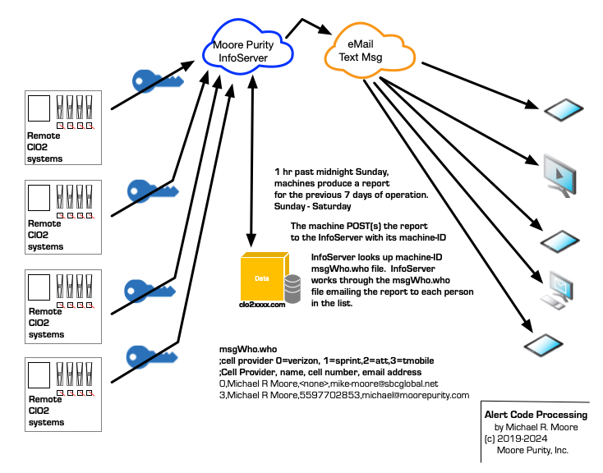
Machine Email Report Services Moore Purity Cloud Services

Slide 25
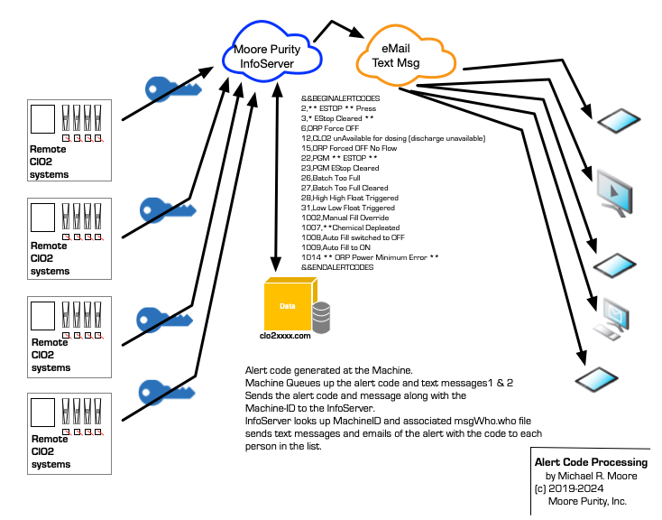
Machine Text/Email Alert Services Moore Purity Cloud Services
Not Shown is Encrypted tunnel controls

Slide 26
Regulatory Uses
Federal Drug Administration (FDA)
Antimicrobial agent in water used to wash seafood, red meat, poultry, and raw agricultural commodities (21 CFR 173.325).
Antimicrobial agent in water used to wash poultry, fruits, and vegetables (21 CFR 173.300).
Terminal sanitizing rinse, not requiring a water rinse, on all food contact surfaces (40 CFR 180.940).
U.S. Department of Agriculture (USDA)
P-1 approval for bacterial and mold control in federally inspected meat and poultry processing plants for environmental surfaces.
D-2 approval as terminal sanitizing rinse not requiring a water flush on all food surfaces found in food processing plants.
D-3 approval as a substance for washing fruit and vegetables that are used as ingredients of meat, poultry, and rabbit products.
G-5 approval for treatment of cooling and retort water in official establishments operating under the Federal meat and poultry product inspection program.
National Organics Listing
NOP as a Synthetic substance allowed for use in organic crop production (§205.601.a.2.ii)
NOP as a Synthetic substance allowed for use in organic livestock production (§206.603.a.7.ii)

Slide 27
What are Moore benefits
Moore has delivered results.
Minimal factory down time, does not need to be shutdown to be cleaned. Factory can run an additional 8 hours every 72 hours.
Improved ROI on the factory investment. Plus 11% ROI and Production.
Reduction in operating costs. (Save 8 hour cleaning shift every 72 hours)
Reduced injuries. Less slip and falls.
Cleaner and better smelling facility for showing potential customers.
(Story)
Reduce spoilage +30% yield, increase shelf life, eliminate returns.
Reduction / elimination of H2S through out facility.
Whatever my costs are to you are, they are returned as additional dollars to your bottom line. (discuss)

Slide 28
Chlorine Dioxide Returns Factory Time
Use of Moore Chlorine Dioxide allows
a facility to run 24/7.
Very valuable opportunity to
recover capital investments and
Improve ROI
Based on a 106 day harvest an
average of 72 hour run before clean cycle
and 8 hour clean cycle. Generally the
clean times are longer (8-12 hours).
Restart costs are eliminated.

Slide 29
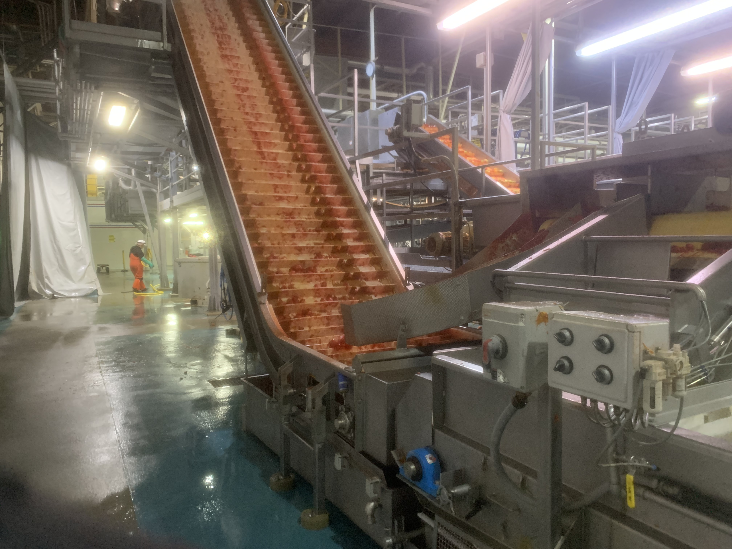
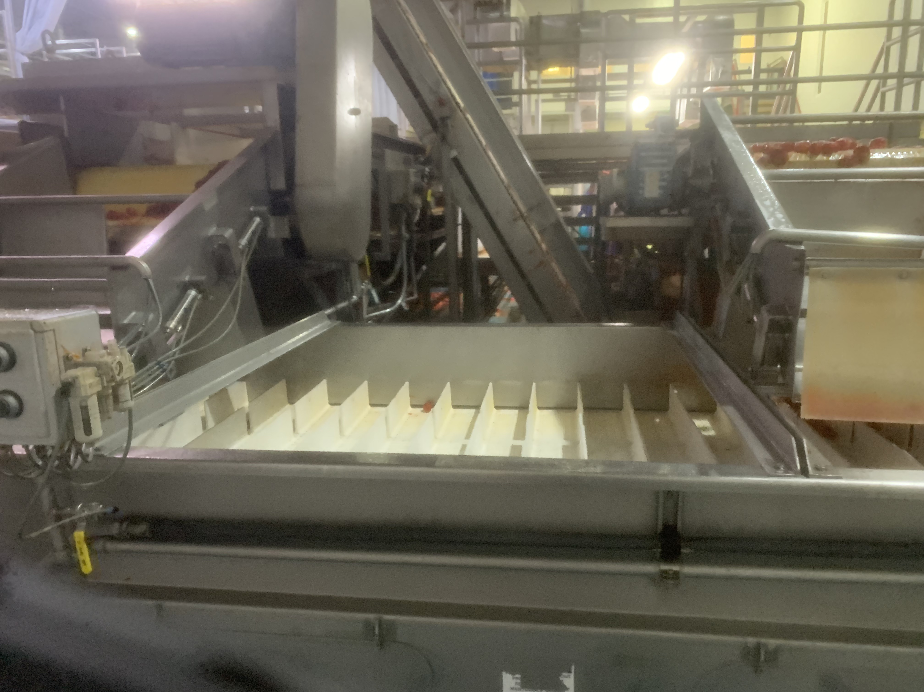
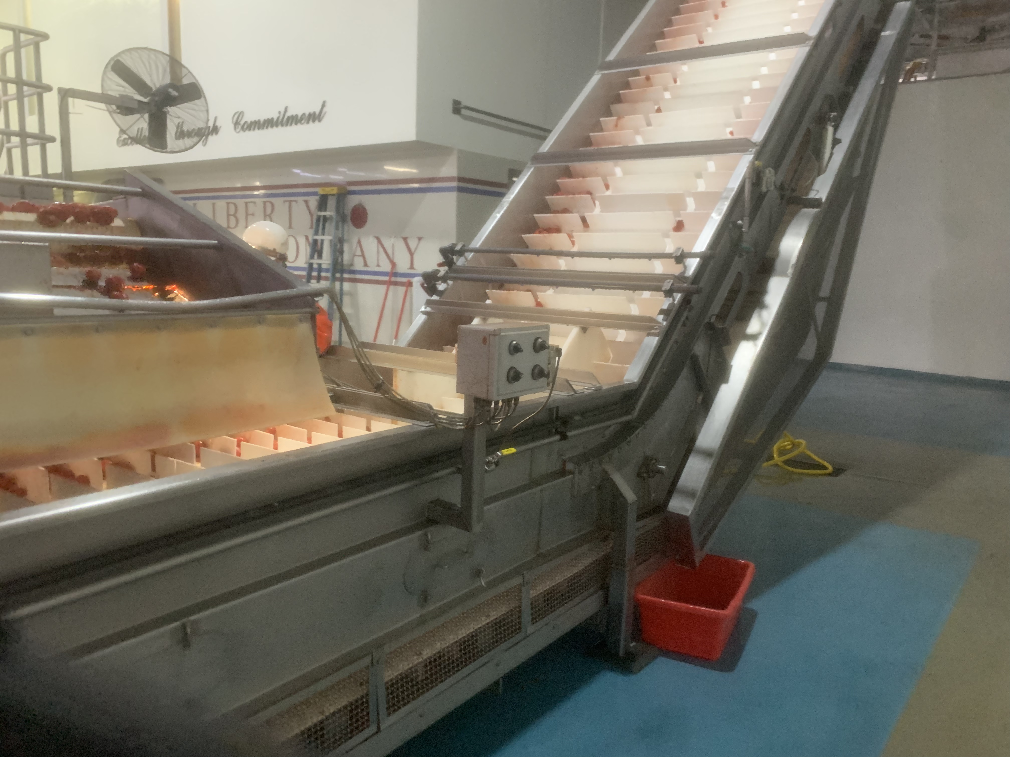
Chlorine Dioxide Reduces Sanitation Costs
Untreated
Treated
Treated
Same product goes to each belt however the belt on the left is untreated, the belt center and right treated with chlorine dioxide
Spray bars.
This is a very good example of costs savings; this also clearly illustrates our processes remove contaminates reducing waste and
risk of contamination. The results are reduced spoilage, improved yields, cleaner facility and additional profits.

Slide 30
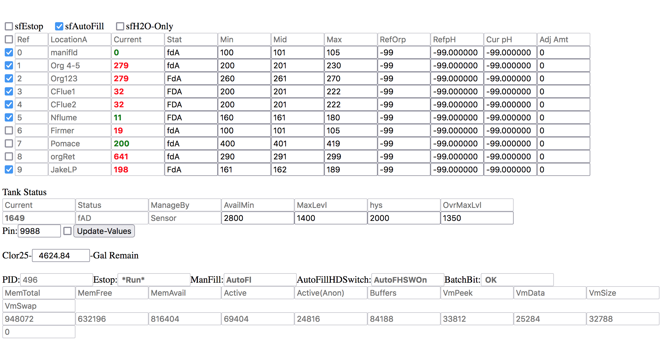
Multi-Dose Example

Slide 31
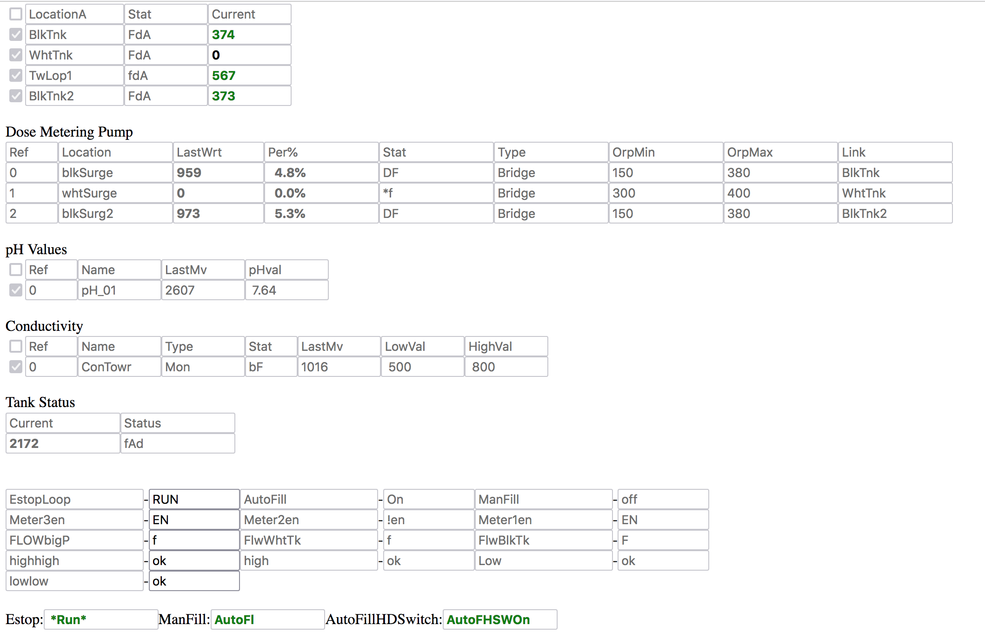
Sample Cooling Tower with pH and Conductivity Monitoring

Slide 32
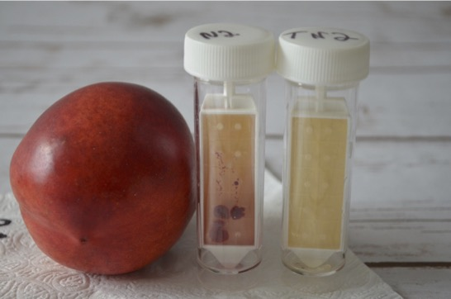
Before & After
These items were purchased directly from a store. Sources unknown. Before tube on left unknow pre treatment. Right tube after Moore Purity Treatment.

Slide 33
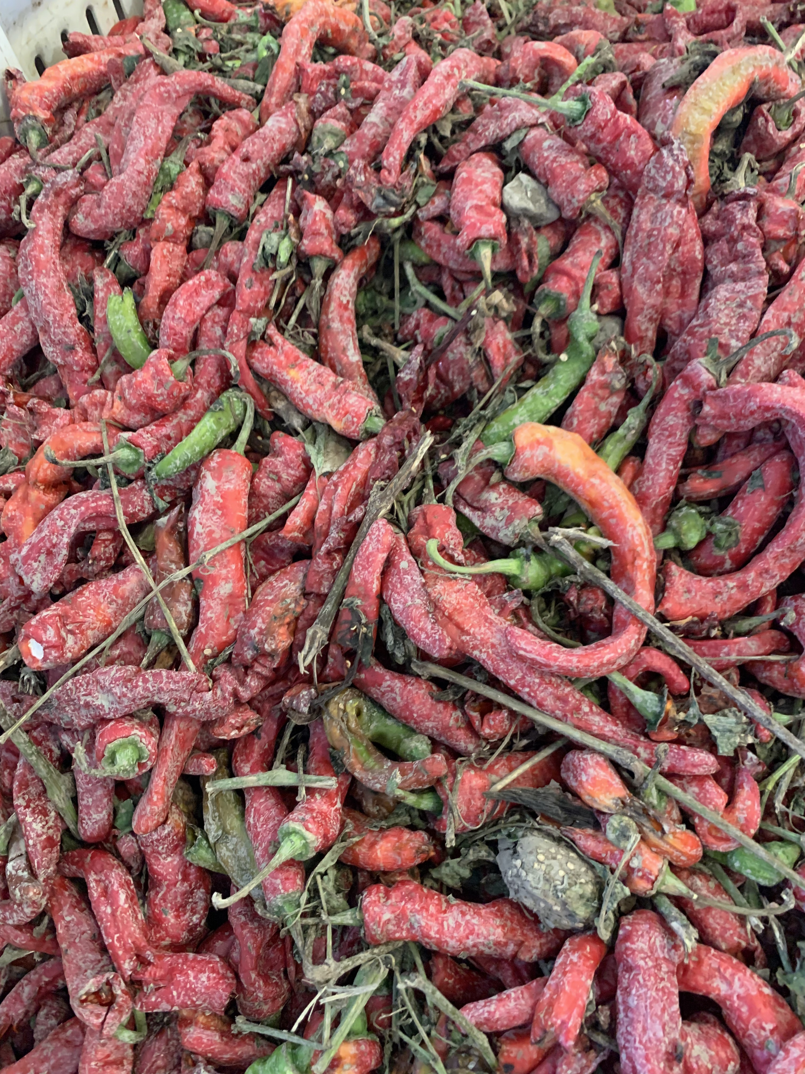
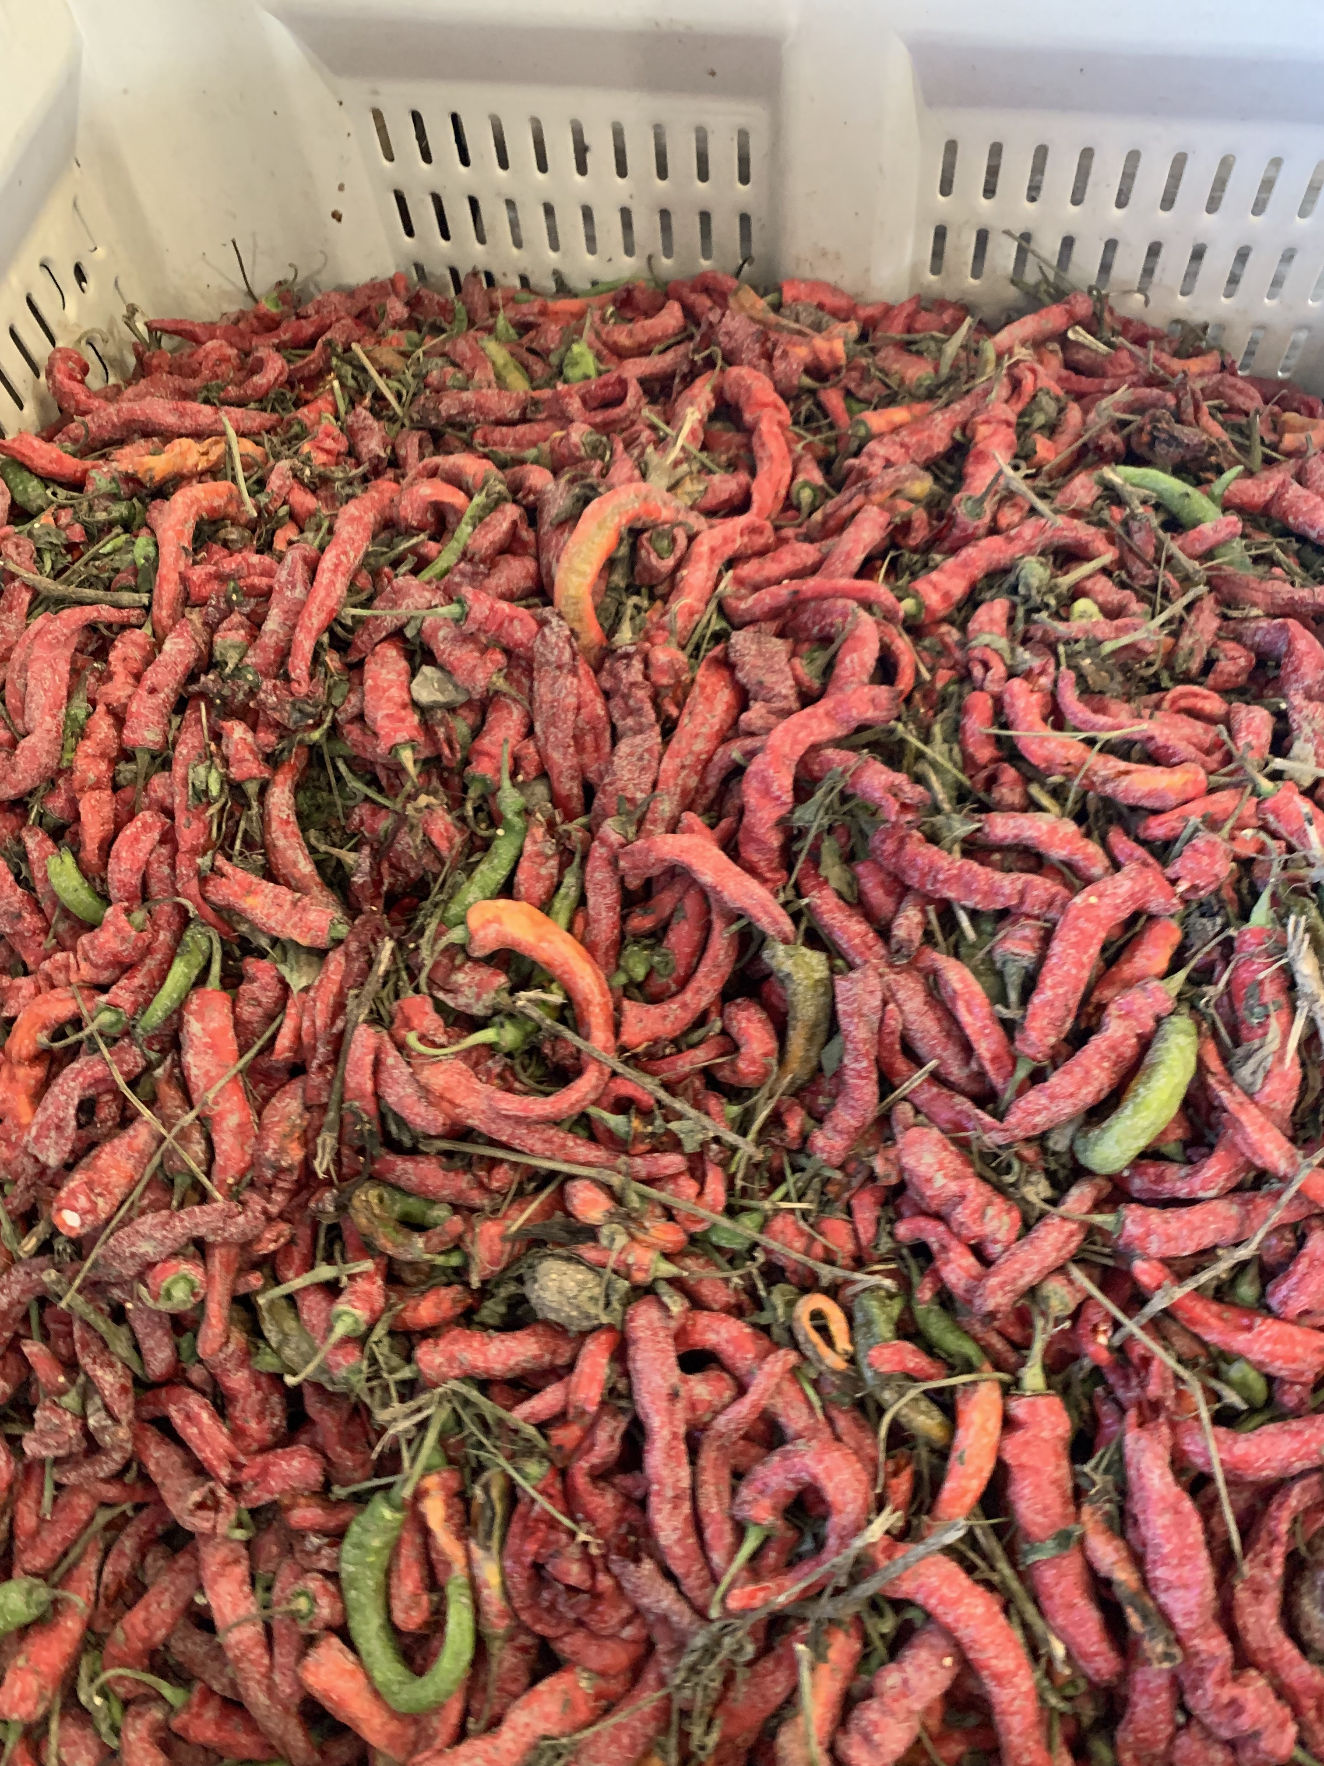
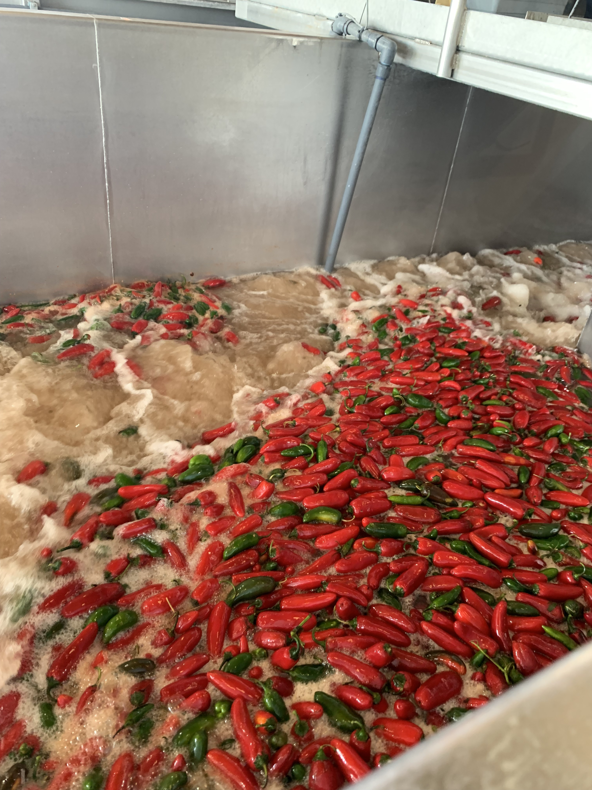
Before & After Visual
Before Treatment
Before Treatment
Treatment

Slide 34
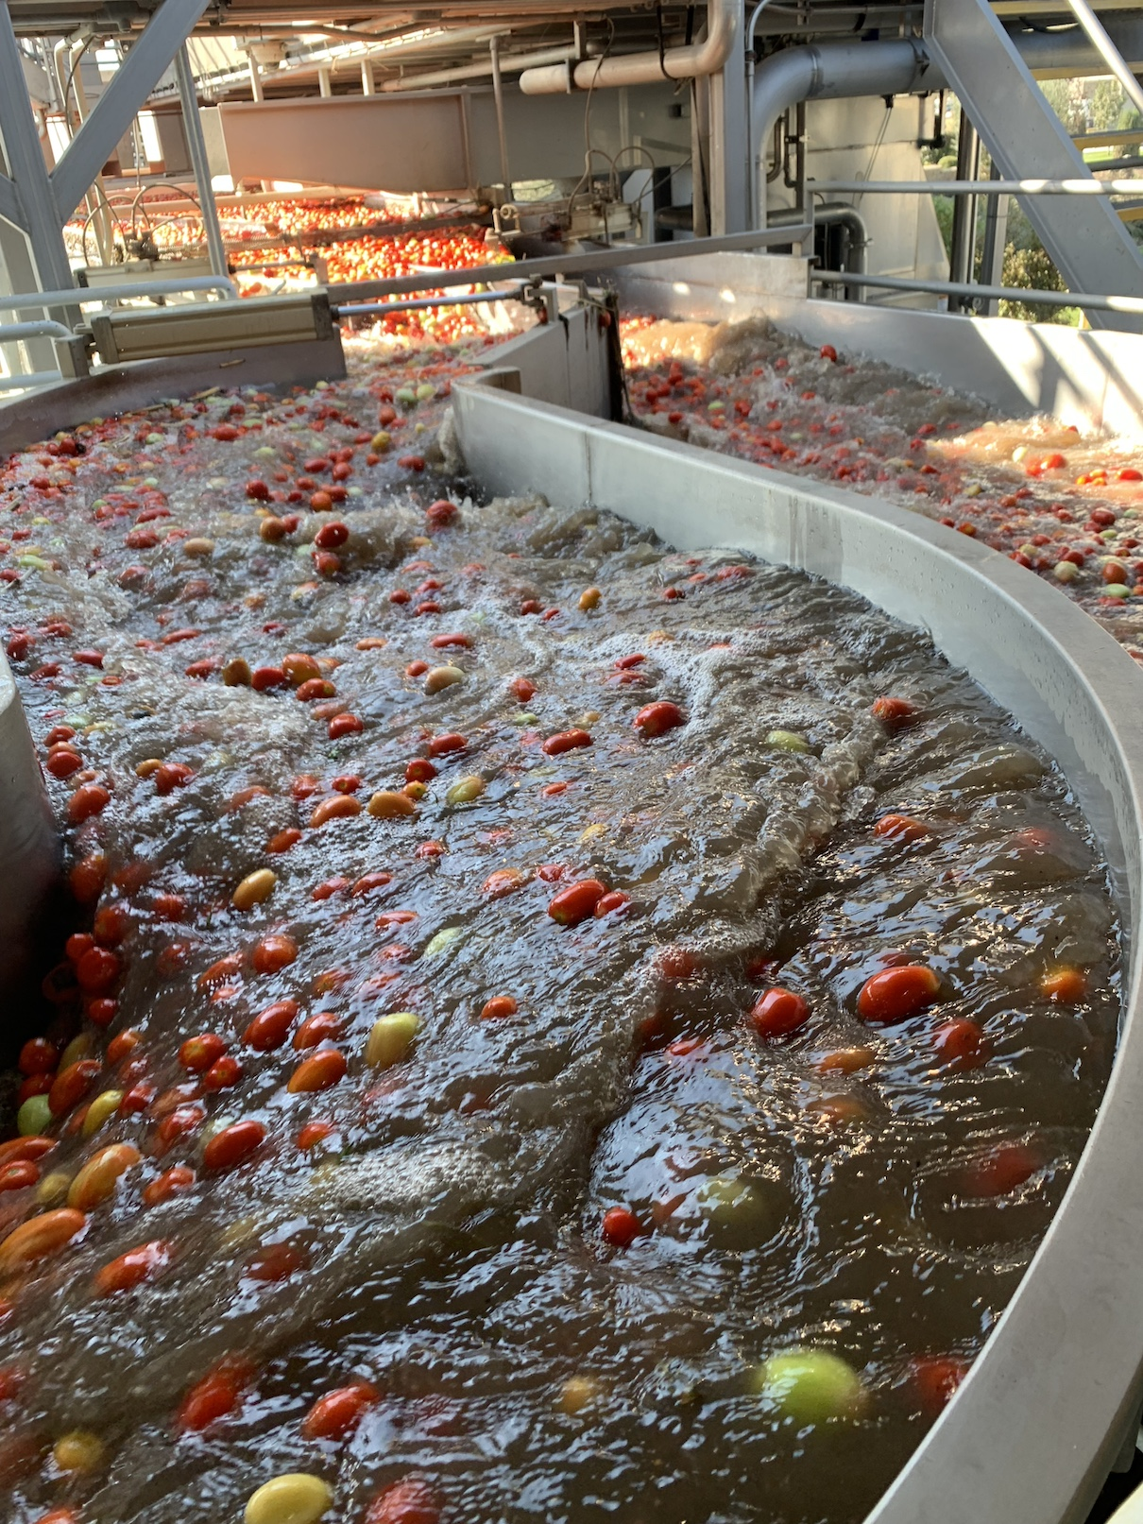
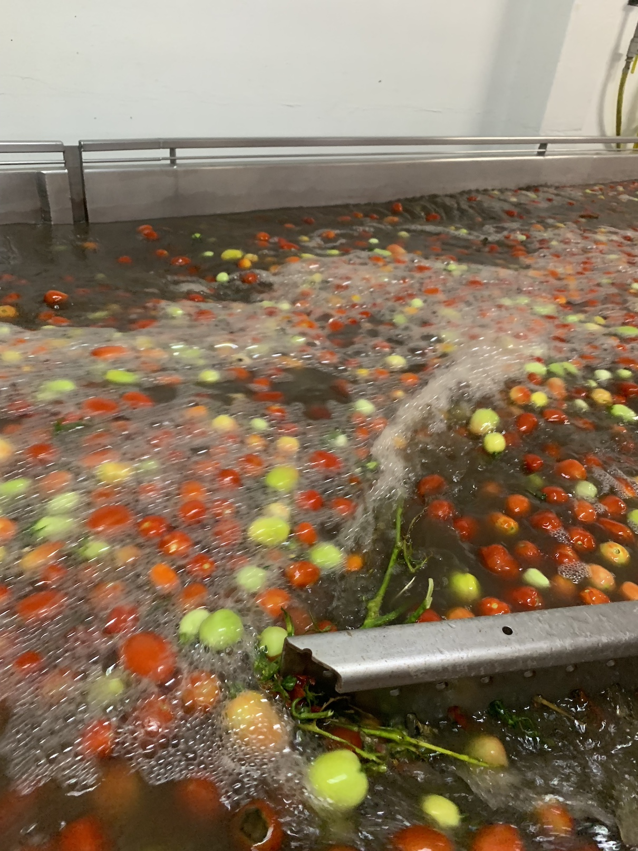
Turbidity Safe Water

Slide 35
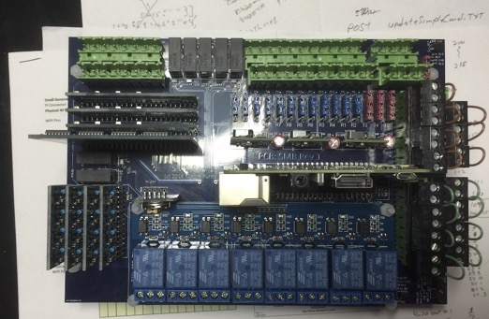
Moore Purity SMB Control Board

Slide 36
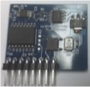
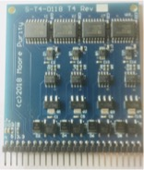
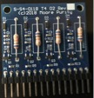
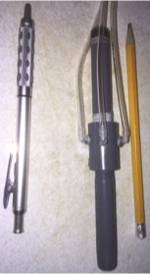
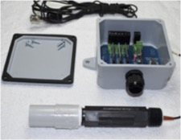

Moore Purity Sensors, Transmitters, Receivers, Input & Mini-Reactor

Slide 37
Background of Inventor
Michael Moore
2017 – Present Moore Purity CEO/Engineer
Engineered a complete line of sensors, transmitters, control systems and cloud services to support all applications of Chlorine Dioxide. Including all the hardware PC boards and software.
Expanded the sales for the company from $540K in 2017 to $2.1m in 2023.
Increasing Gross Margin from 21.3% to 55.4%
Increasing Net Profit Margin from 15.4% to 68%
Development and deployment of Proprietary automation cloud services.
My Pocket Control Room.
25+ US Patents.
Request a complete profession summary.

Slide 38
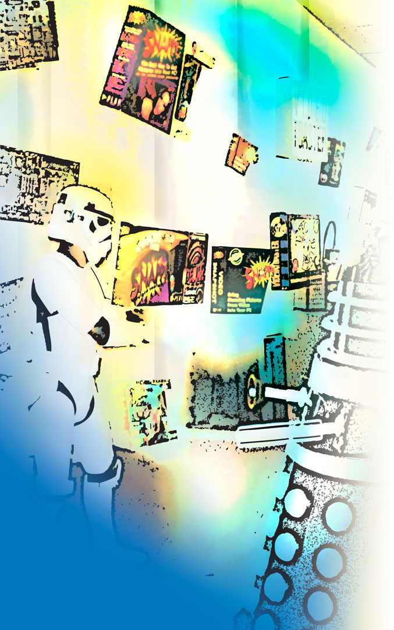
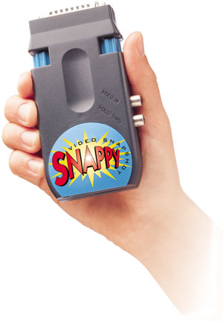

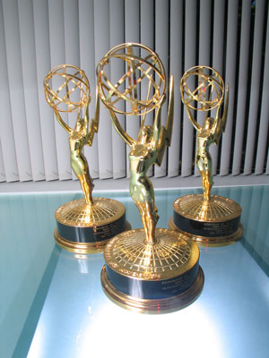

History
Pioneers in Media, Film, Television, 3D, Special Effects and Internet Streaming Technologies
Invented and shipped over one hundred different products to millions customers
Early Internet software algorithms (70's)
Advanced Apple & Amiga video products (80's-90's)
Play Industries, Snappy, GlobeCaster (90's-00's)
Industry awards including three Prime Time Emmy® Awards for Excellence in Engineering Development
Full service telephony, personalized email, web, and interactive video marketing
Marketing partnerships with Microsoft, Toyota, Harrah’s, NASCAR and NCAA

Slide 39

My various teams have a history of creating market leading innovative technologies for over 30 years. My Products have ranged from consumer video technology products to State-of-the-Art professional visual effects products used in television and film. Now innovations in sanitation technologies and services.

Slide 40

Trinity / GlobeCaster
Designed, Developed & Manufactured starting in 1995
Over 30 Custom Chips
Massively parallel pipelined D1 Broadcast Production System
Multi-channel Real-time Ray-traced 3D Video Warping Effects
3D Virtual Sets with Physically Accurate Reflections & Refractions
Real-Time Hardware Non-Linear Editing Module (no rendering)
Multiple Direct-to-LAN Streaming Video Output Modules
Feeds live content streams into Edge-of-Internet CDN systems (i.e. Akamai)

Slide 41

My technologies have been used to create dozens of television series and major motion pictures such as Star Wars: Phantom Menace. This is a shot of my Museum which has props from some of the Television and Film projects we have been involved with, as well as demonstrations of technologies that have been created over the years.

